Slide 1
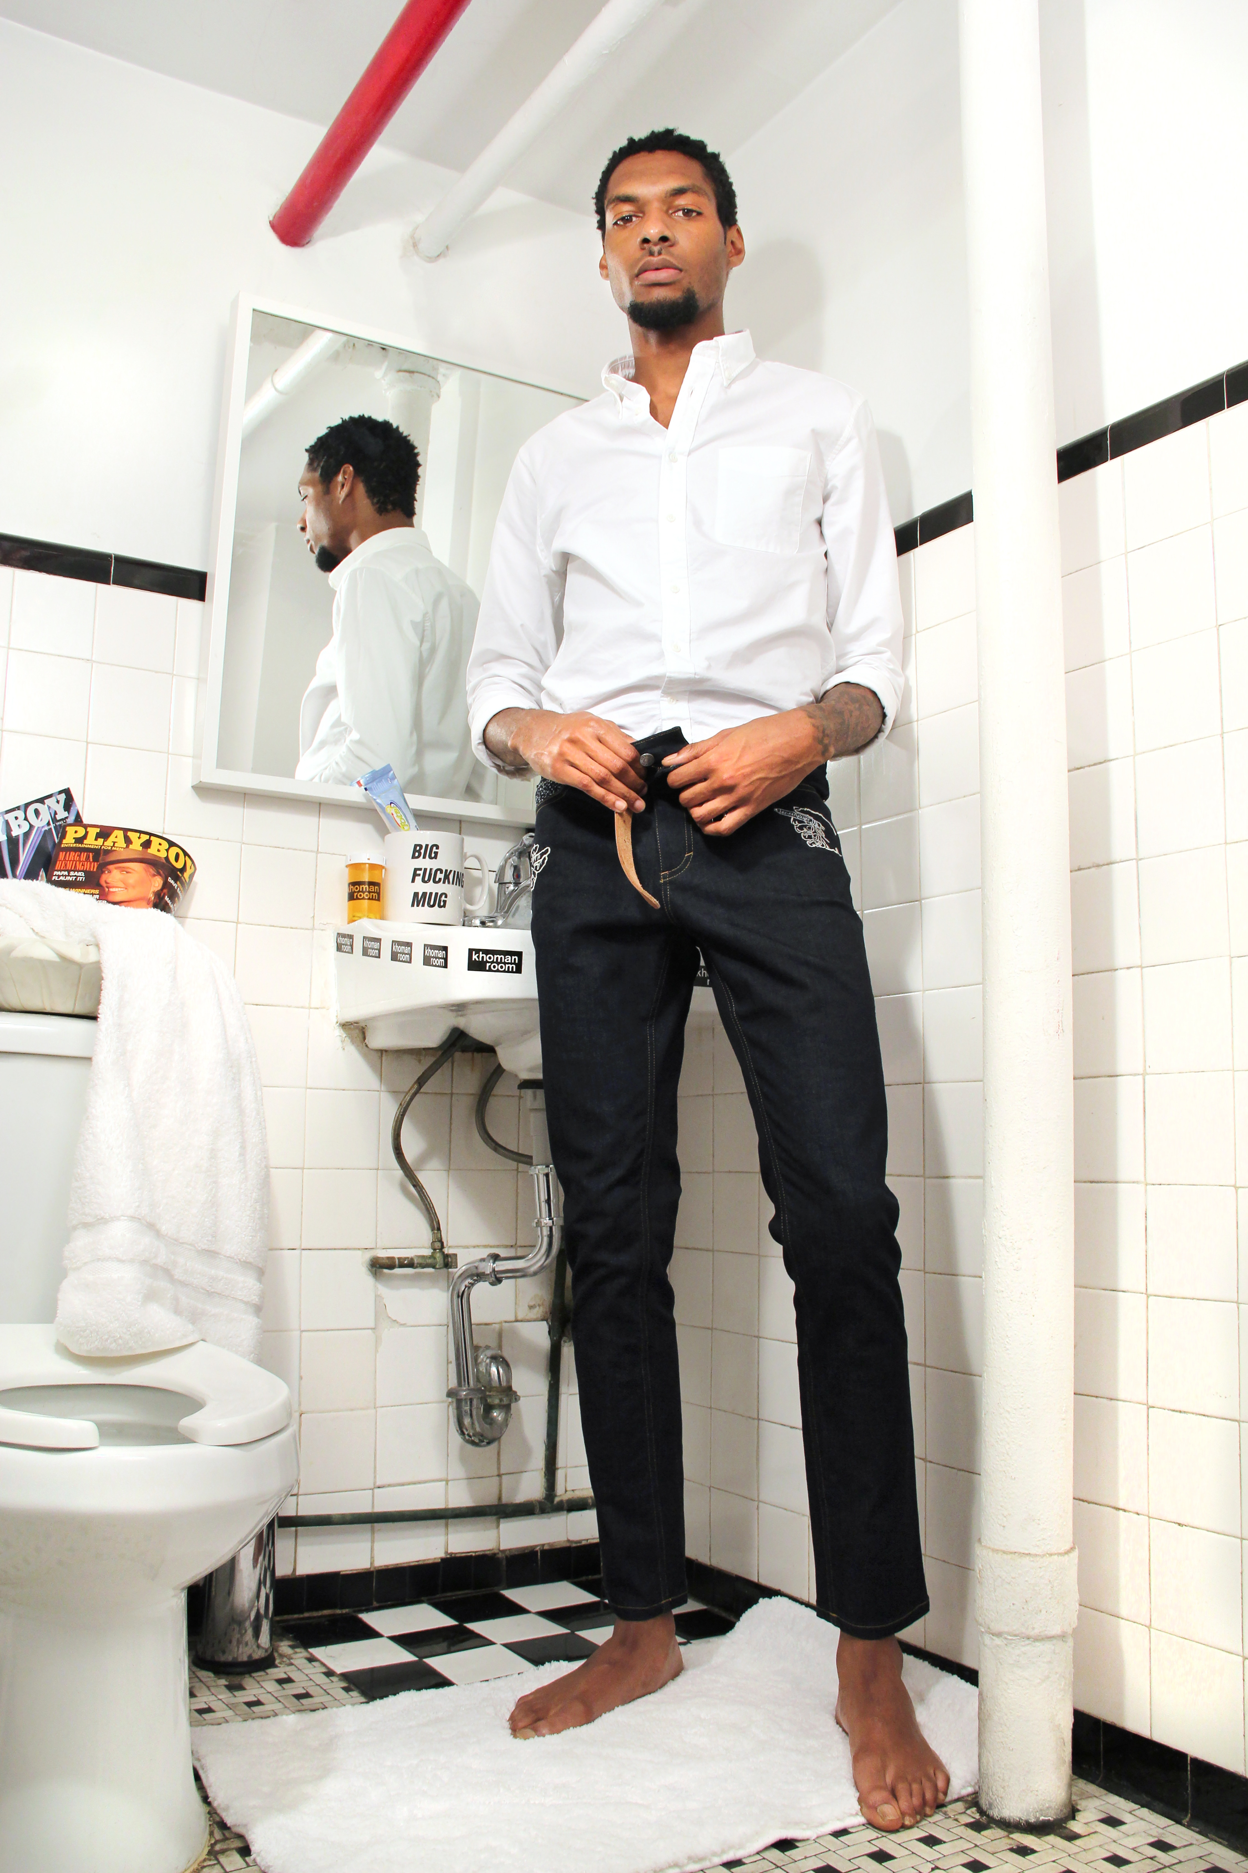
Mojiyo
Honest reflection of the election

Slide 2

Providers of Transparency
Provider | Limitation
INEC | Buyable
Election Observation Groups | Slow, arduous, with limited resources And limited participation
Journalists | Limited focus
Police | Buyable
Becoming an Election Observer
-Biased against Nigerian civil organizations
-3 week arduous
-Resource intensive
-Randomly selected

Slide 3
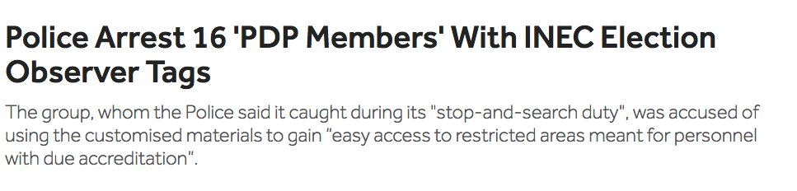

Slide 4
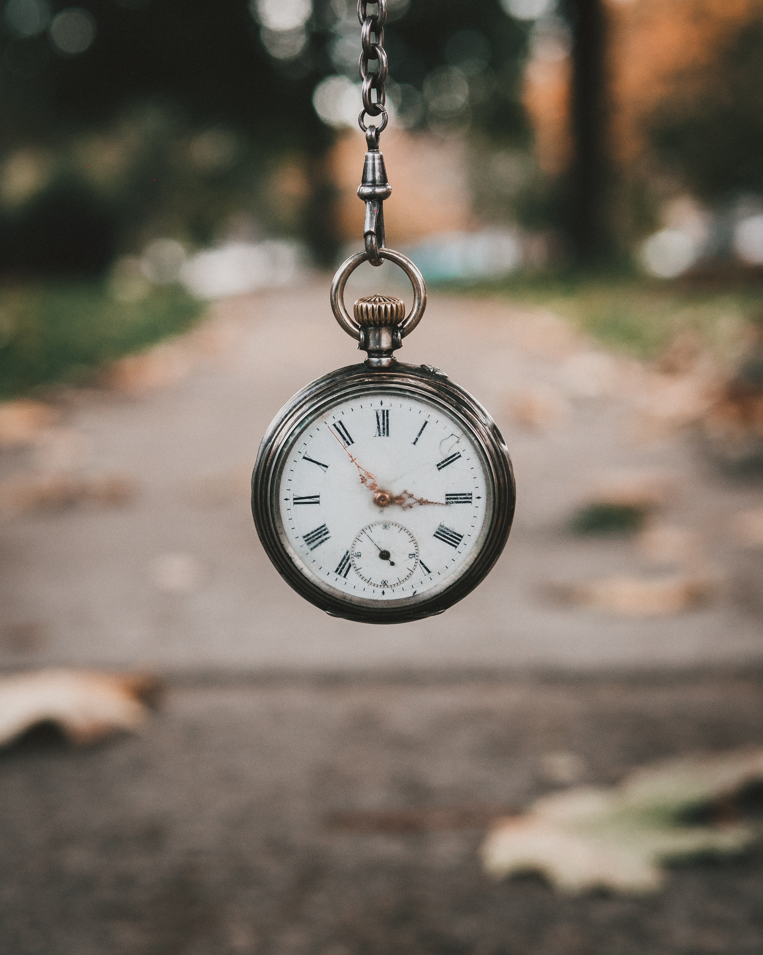
2015 In Dutsi
Why did polls in Dutsi close after only 2 hours?
INEC’s answer
“massive enthusiasm of the voters.”
HRW: Ballots found in possession of officials were 95-100% PDP votes. Few legitimate votes.
Human Rights Watch
Notes:
Problems at polling places were slowly addressed
Ordinary people can’t easily report at

Slide 5
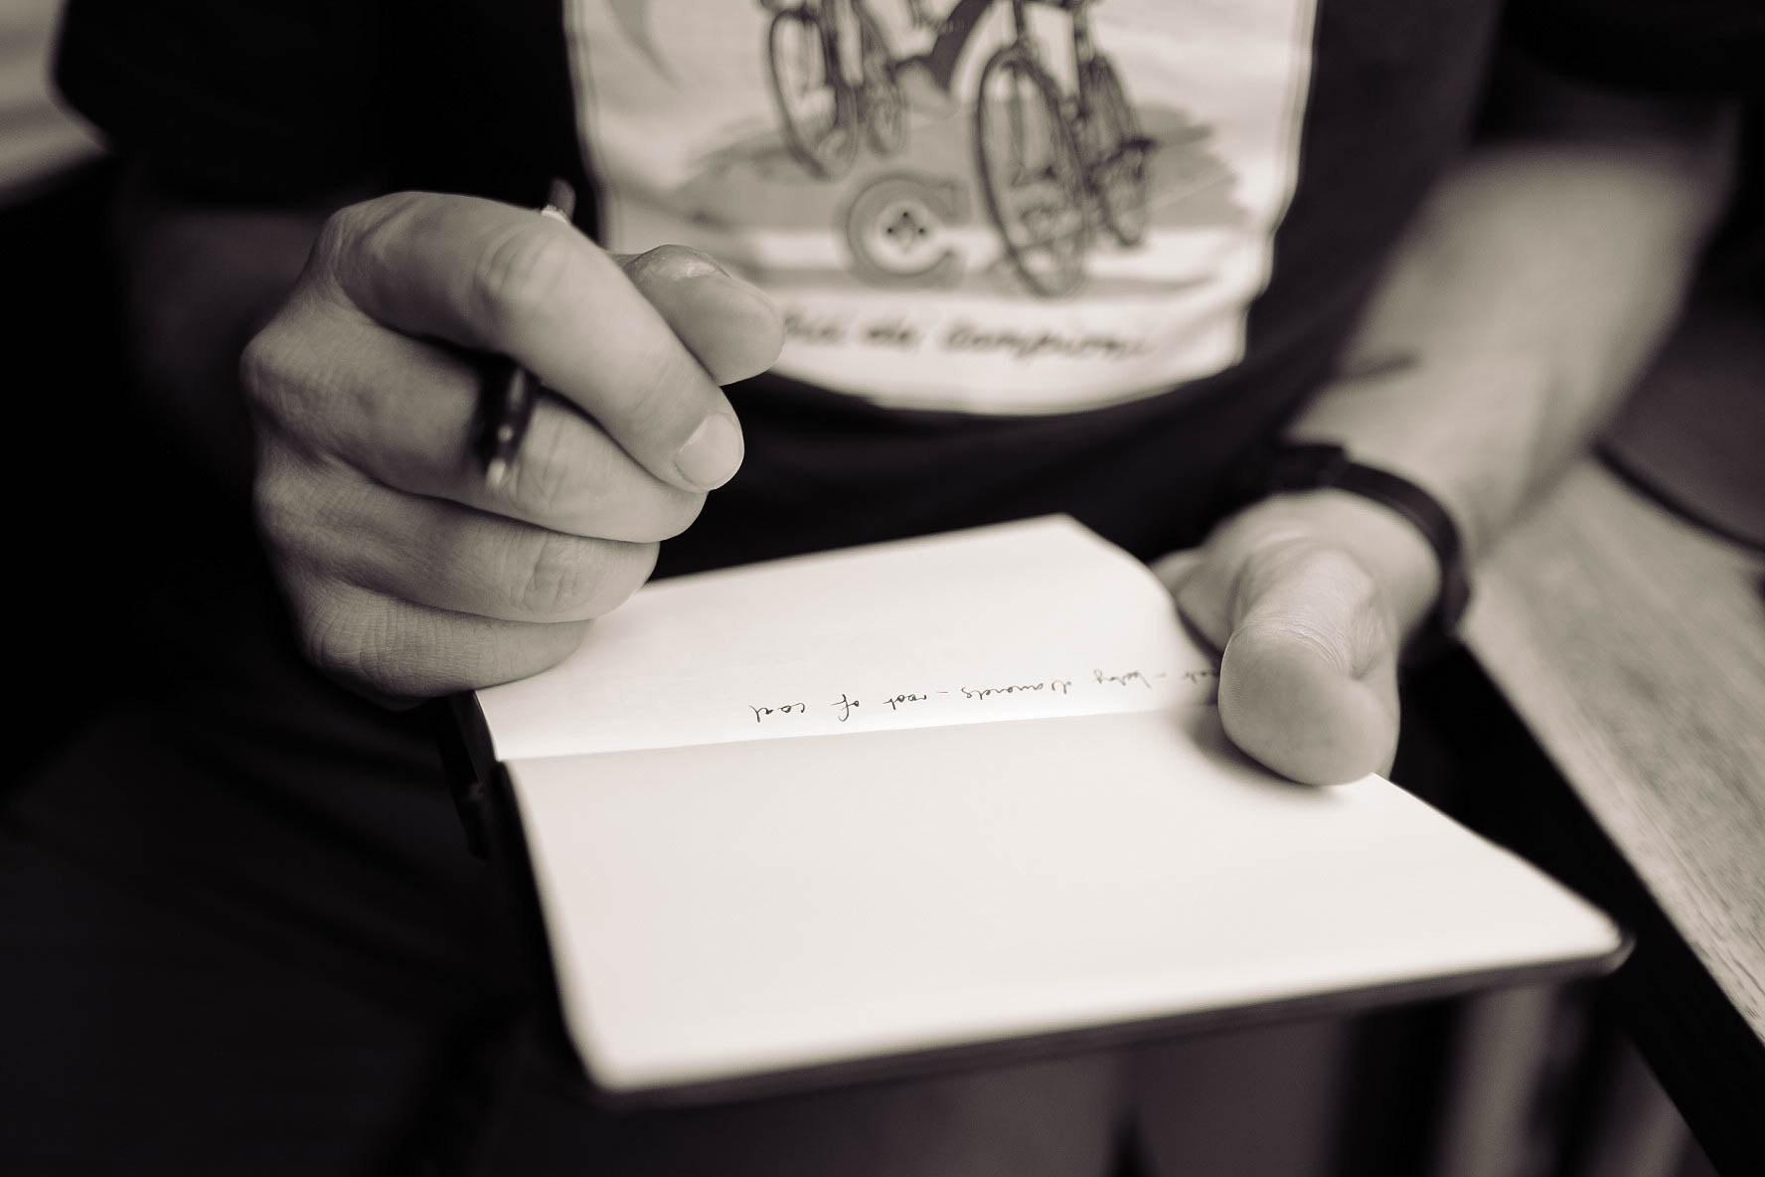
844,519
votes of all votes cast were declared invalid for breaching established balloting rules in 2015

Slide 6
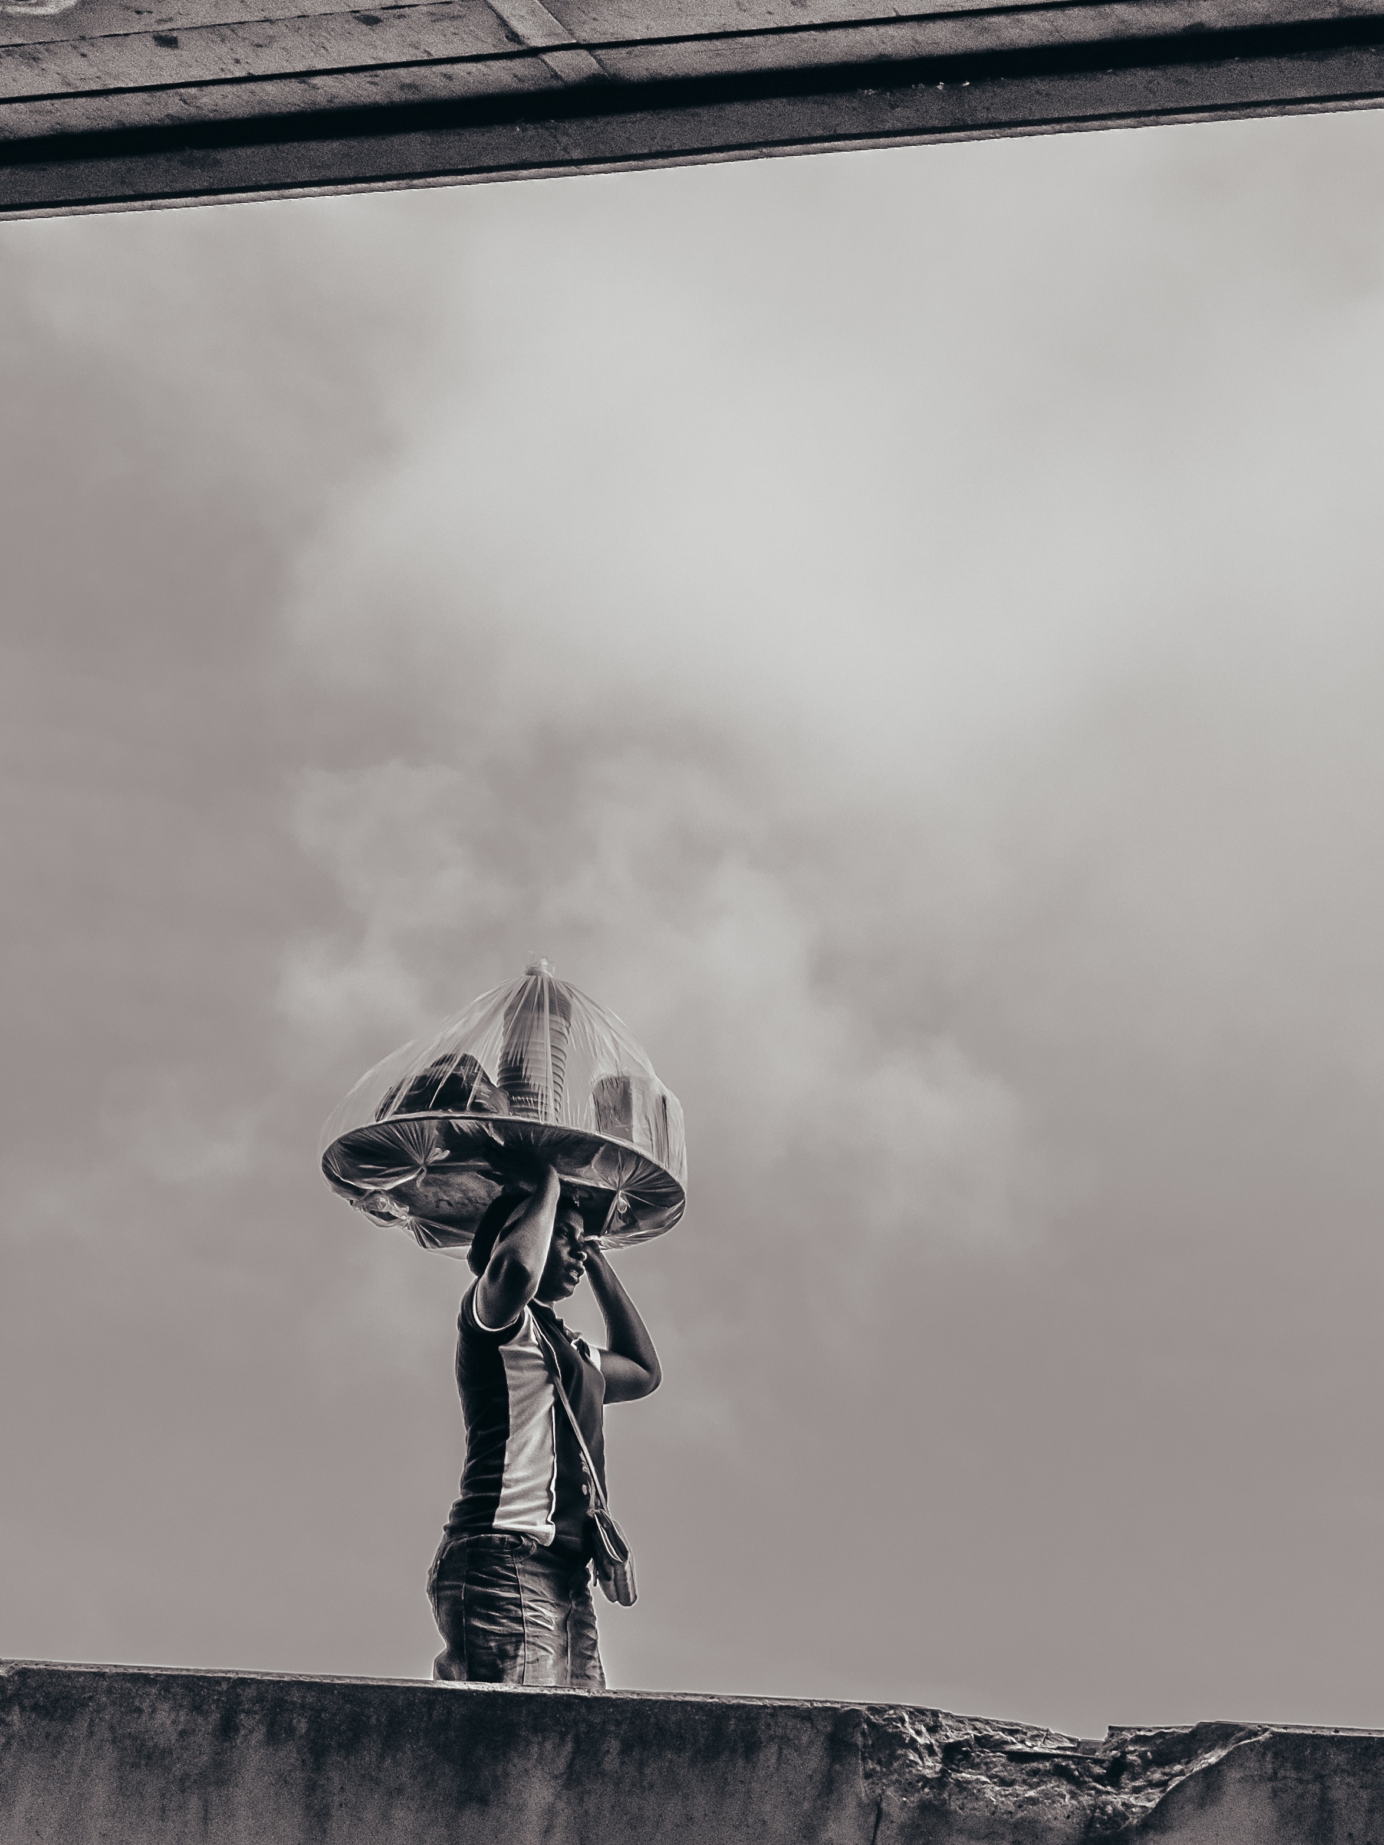
Give vulnerable voters in rural areas access to fast and anonymous election reporting.
Give voters a way
to address election
issues quickly in
areas with the least technology.

Slide 7
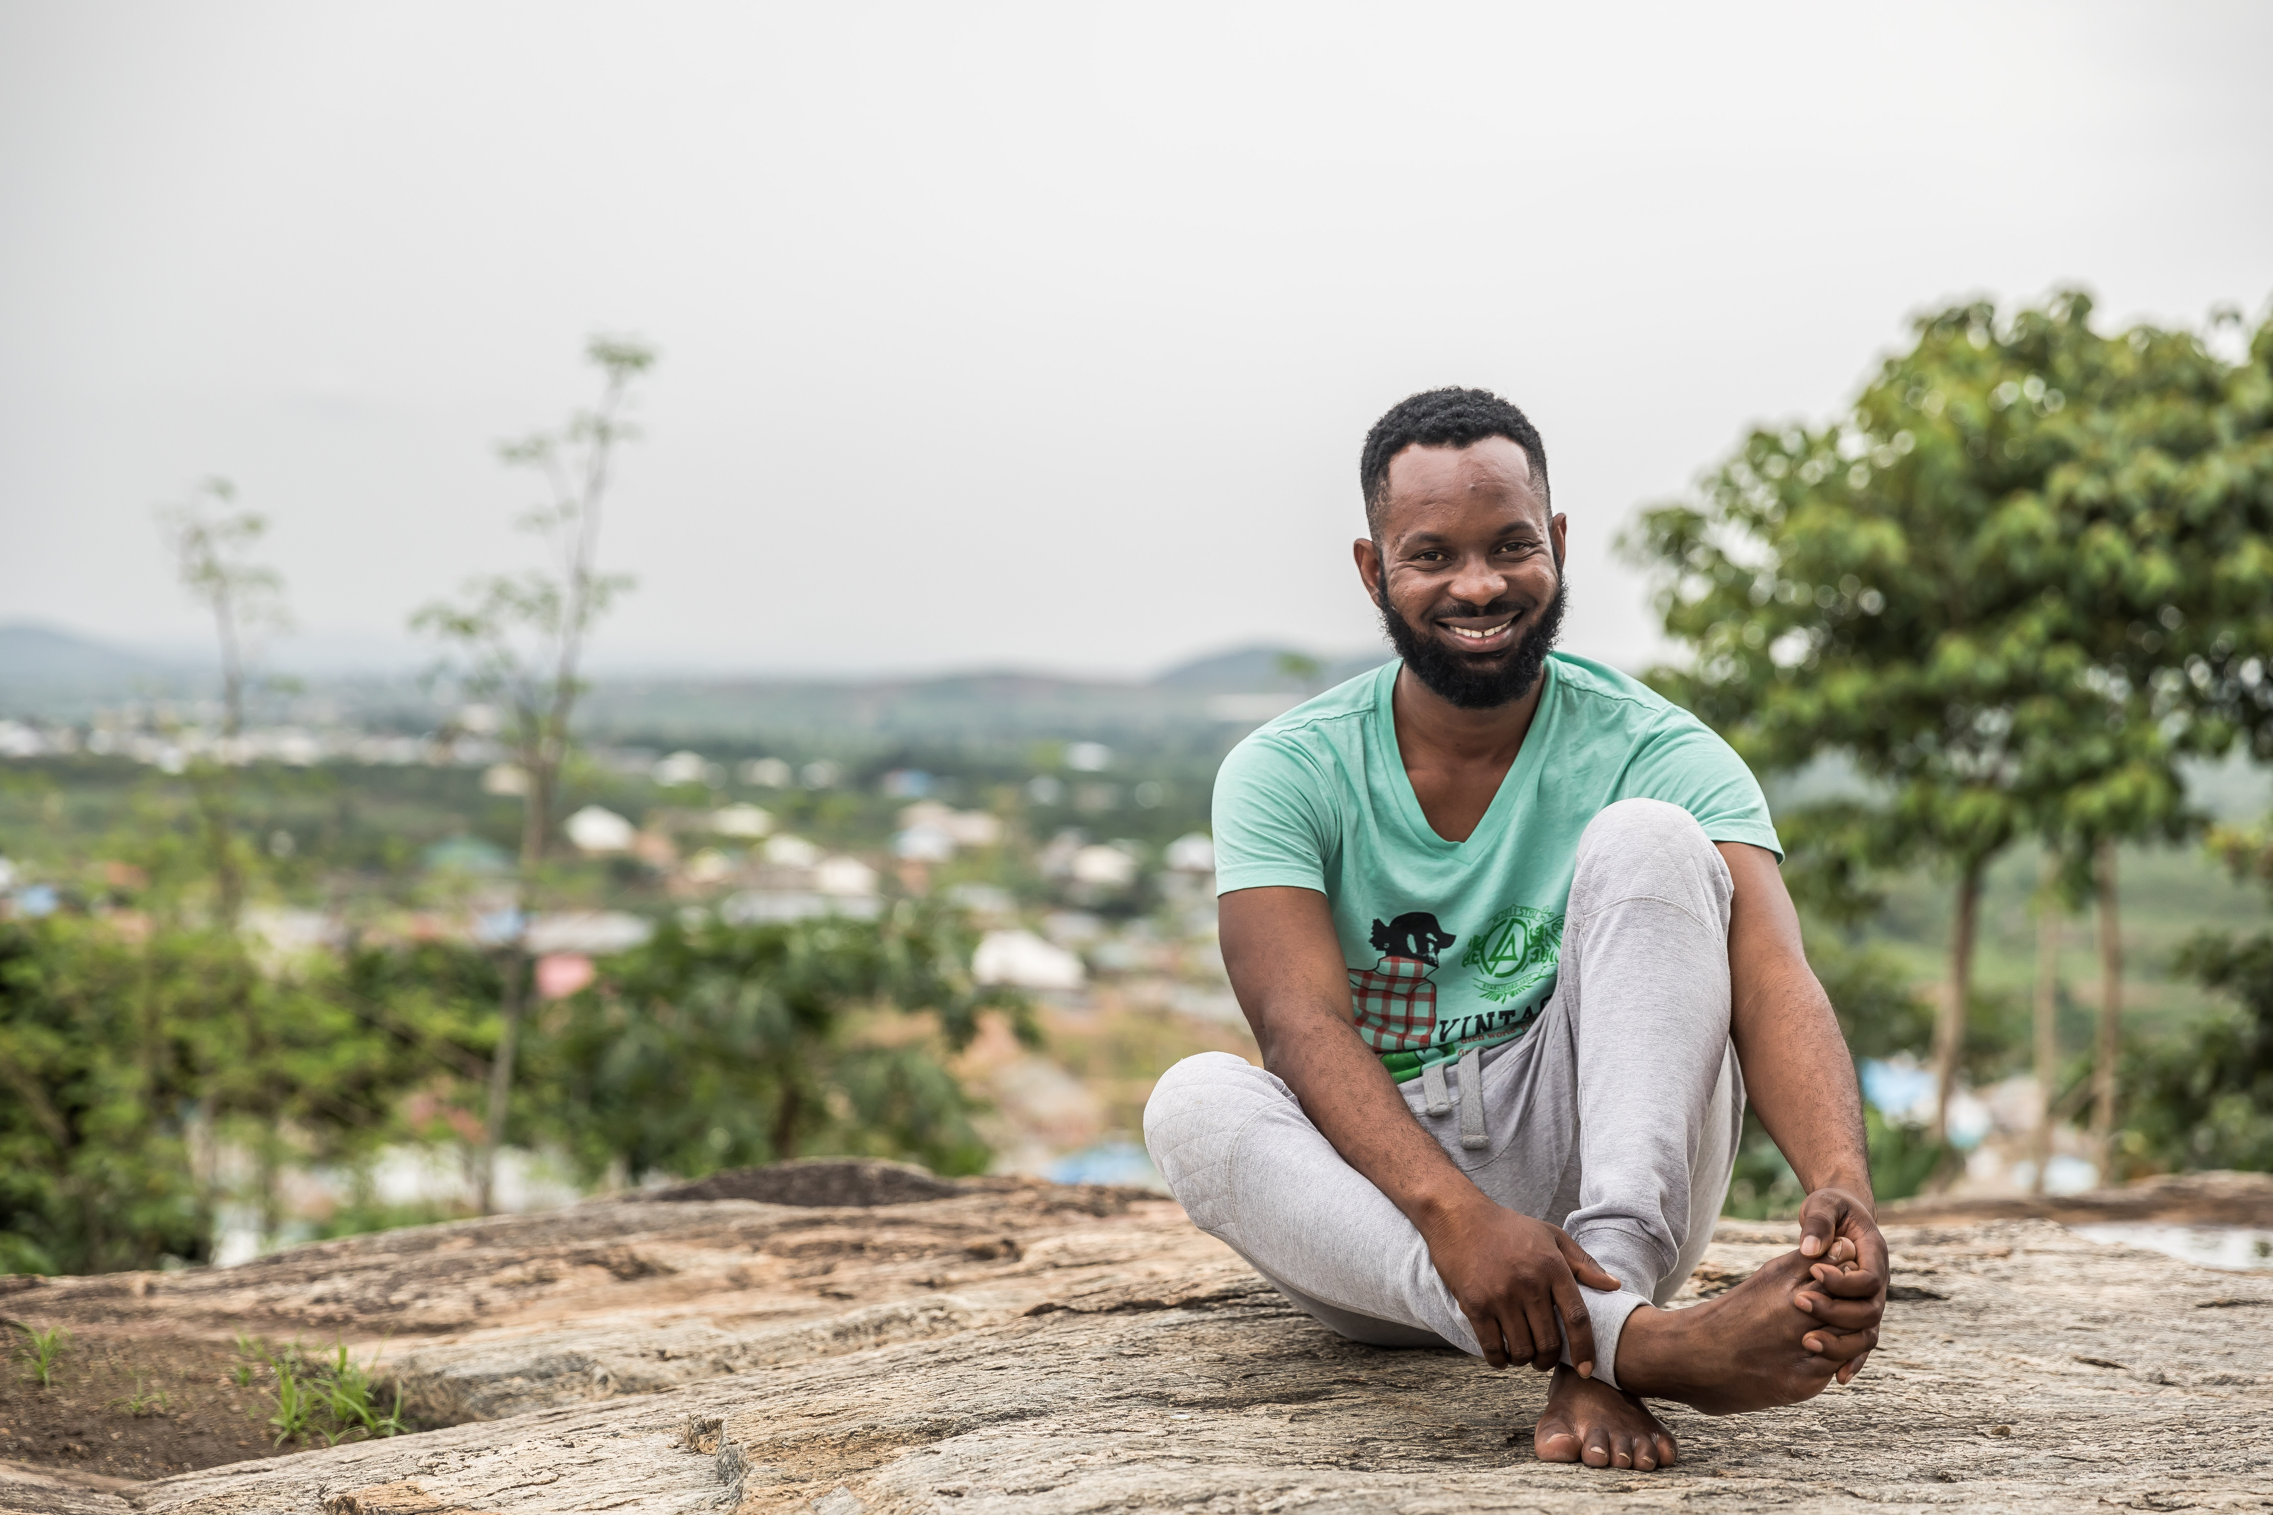
Chuku
Voting in Taraba
Age: 29
Notes:
Last election he tweeted about the corruption, but nothing happened
In 2015, 23,000 votes were rejected

Slide 8
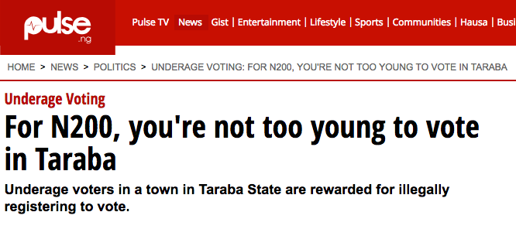
Chuku is witnessing corruption.
There is no official election observer. INEC official is turning a blind eye
What can the Chuku do?

Slide 9
From: MOJIYO Thank you for helping us prevent corruption text us your polling unit code.

Slide 10
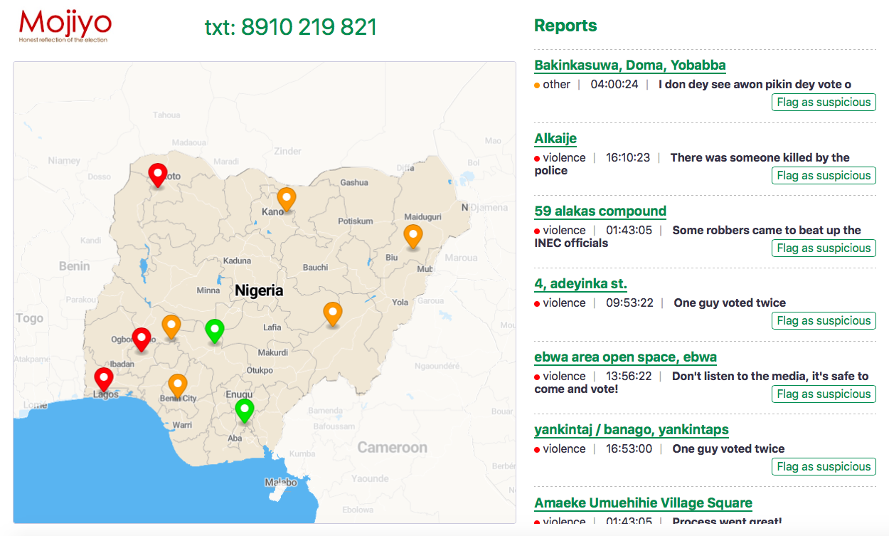

Slide 11

Kemi
Reporting on Corruption
Age: 26

Slide 12
Demo
Mojiyo
Honest reflection of the election

Slide 13
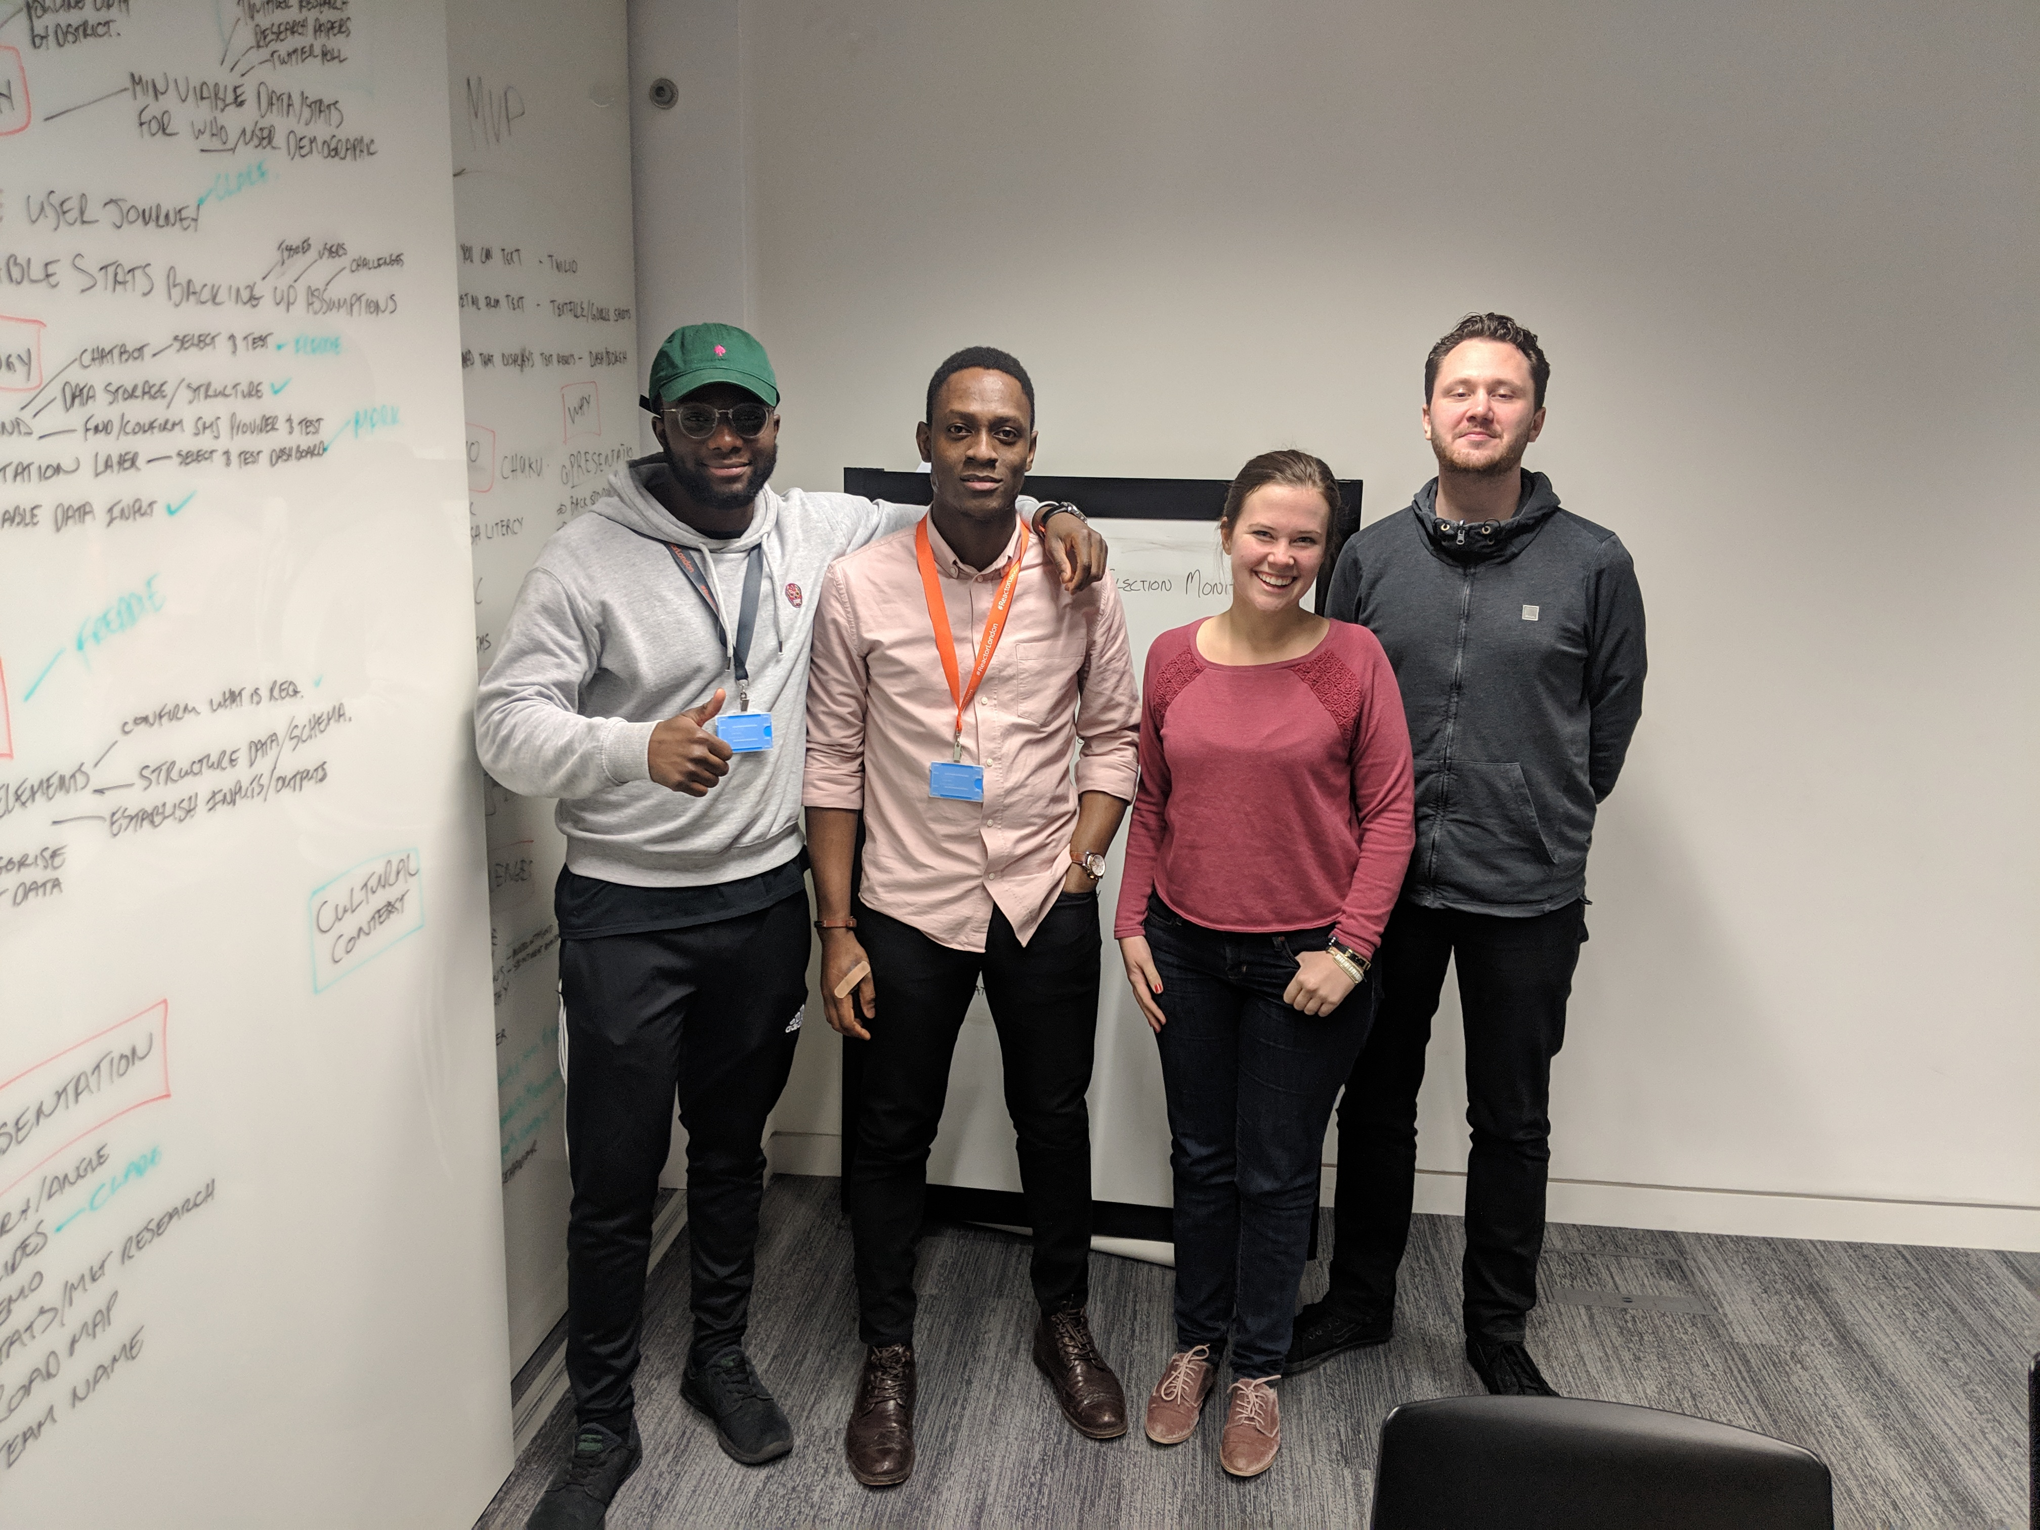
We wanted to help the disenfranchised that are left behind by silicon valley.

Slide 14
Mojiyo

